Slide 1
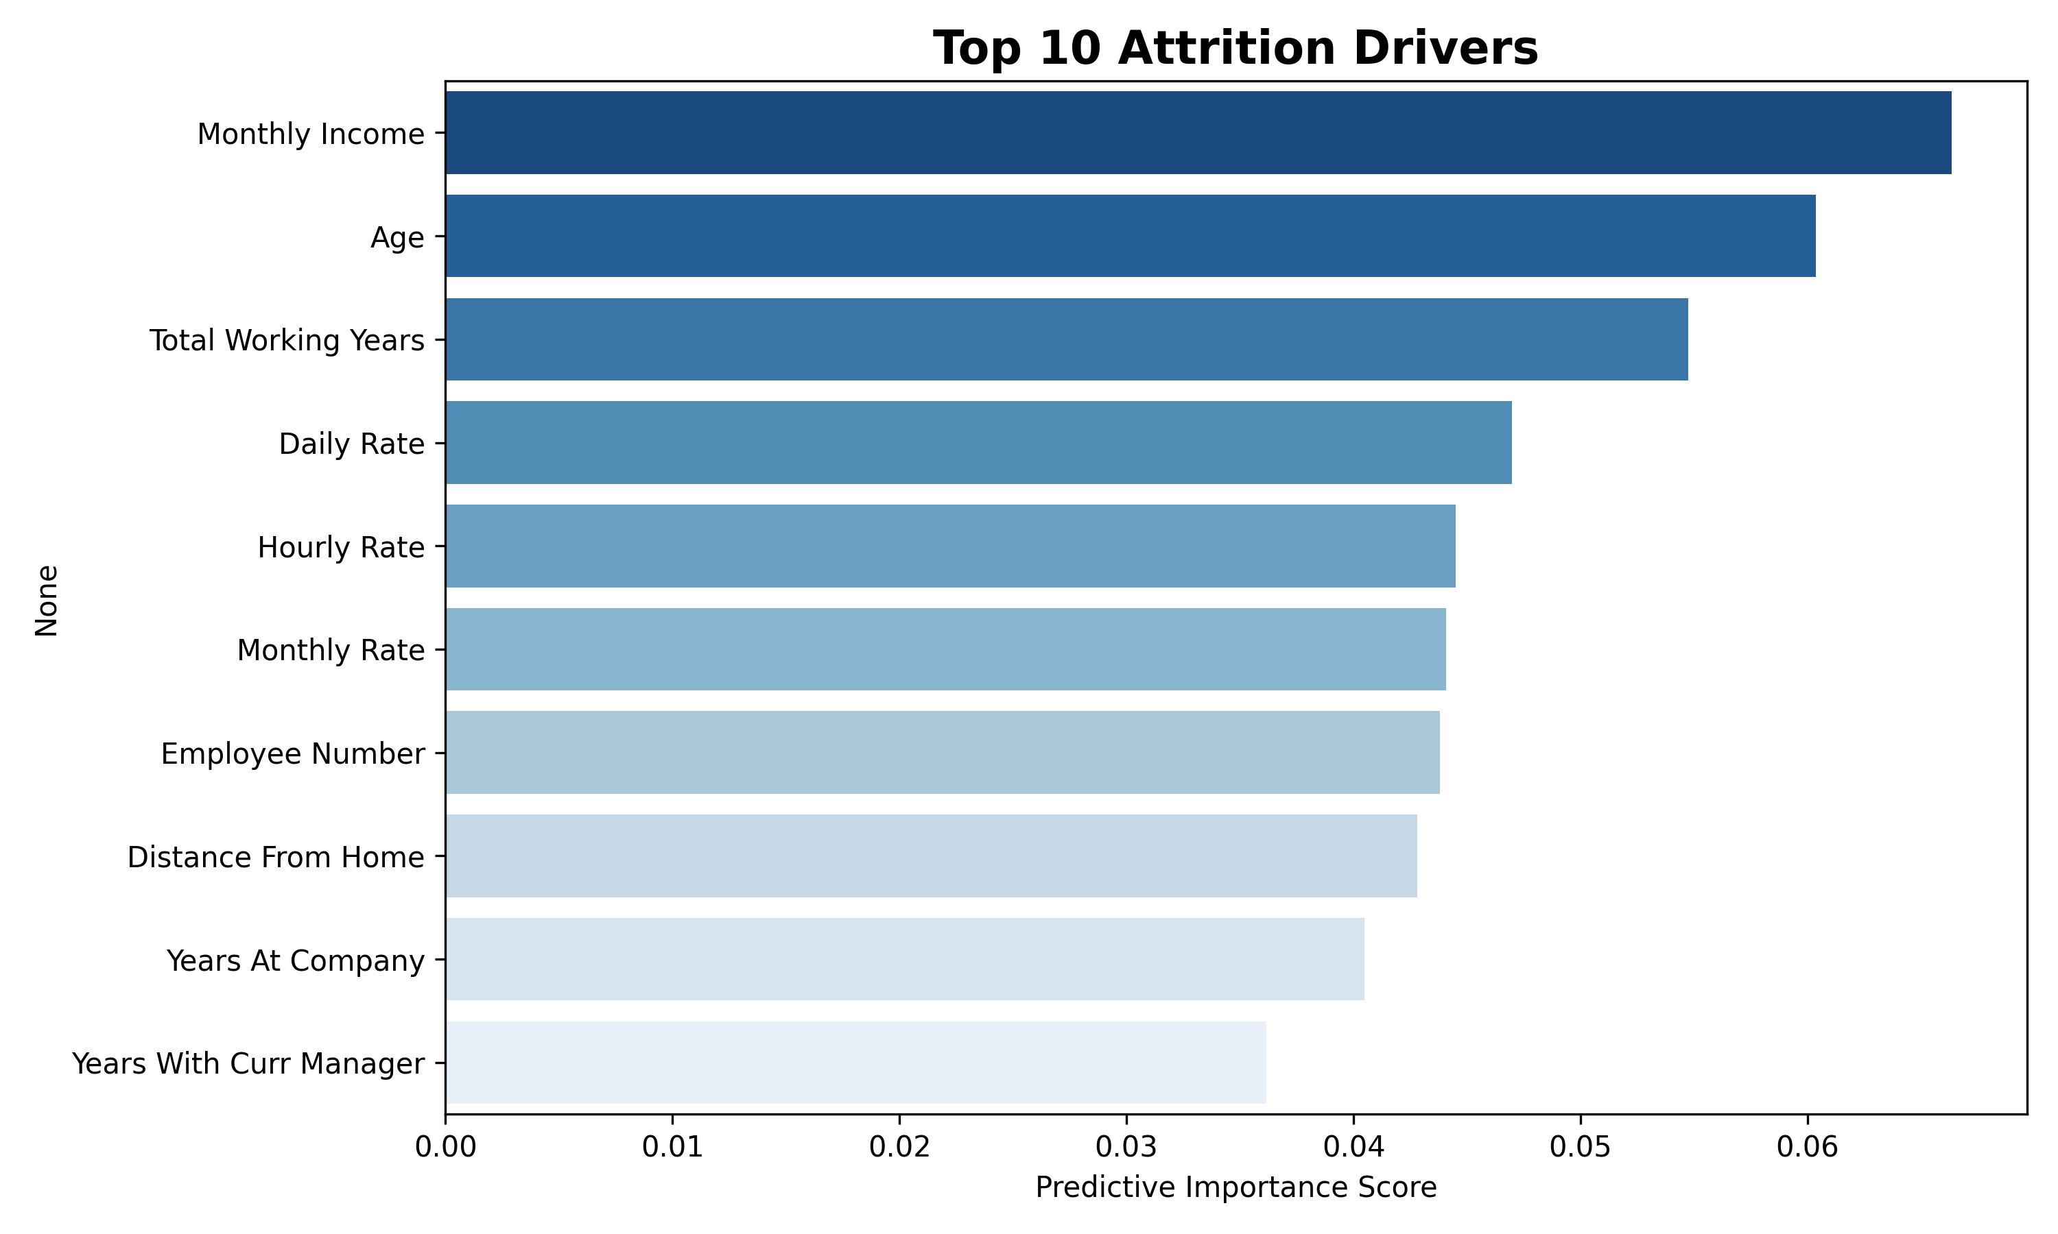
Executive Attrition Analysis & Model Performance
Model Validation Results:
Accuracy: 84.7%
Precision: 58.3%
Recall: 14.9%
F1: 23.7%
Key Analysis Remarks:
Overtime is the strongest predictor of attrition.
Monthly Income levels significantly impact retention.
Tenure at the company reveals high risk for newer staff.

